Slide 1
Hugh Harford
Posco Consulting
March 2018
An outline of the Condor GP Design.
THE DESIGN (note, out of date – 1st August 2018)

Slide 2
About this deck
This deck is in two parts
Firstly, diagrams and a little text to describe a little of the design core
Secondly, text to describe Epics and Stories – these are a good first draft to describe the functionality of the wider design
The immediate objective of this deck is to attempt a first view of the non-functional requirements
For the stories on these, skip to the penultimate slide

Slide 3
Introduction: Objectives and Key Concepts

Slide 4
Objective of CondorGP
An autonomous, risk managing, long-running, trading system.
Notes:
To achieve a good chance of success, minimum human decision-making is intended. This will aid objectivity when trading, reducing emotionally-driven mistakes
Decision-making will be achieved instead via genetic programming and code output.

Slide 5
Underpinning Concepts 1 of 2: Genetic Programming
Genetic Programming (GP) is a stochastic search AI technique
John Koza is a leader in the field, see: http://www.genetic-programming.com/johnkoza.html
GP requires well-designed Fitness Function – a misfiring Fitness Function can result in unintended results
A useful Functional and Terminal set is important. These are the genetic building blocks, or DNA
A Population of Evolved Individuals is evolved over many Generations. Each Individual is assessed against the Fitness Function, with those scoring ‘most fit’ influencing future generations
Various types of breeding, mutation are used to initially create a population and then continue to investigate the search space
Use of random numbers underpins the evolutionary variations, and GP is known for producing unexpected and ‘different’ outcomes
GP provides the fundamental and objective source of decision-making for CondorGP

Slide 6
Underpinning Concepts 2 of 2: Living Cells
Living Cells are one of the primary USP of CondorGP
The concept comes from ‘Web of Life’ by physicist Fritjof Capra, see: http://ds1416.risd.gd/uploads/CAPRA_WEBofLife.pdf, page 156ff
CondorGP Living Cells will implement a simple definition of a living system, such that to be living the system has:
Has continual throughput of energy (cash and information)
Creates and maintain its own boundary (trading reserves)
To maintain the living status of Cells, each will be tapped (like a rubber tree) for a small consistent amount each month
The living status of each Cell will determine if trading will continue:
If the trading reserve meets certain criteria, the cell is still alive,
Otherwise the Cell dies, and any reserve left is recovered
If the reserve grows very large, a clone or split is made into 2 cells
Greater security is represented by trading well to create surplus, and therefore be longer able to stay alive and continue to be tapped
The above represent the overall Fitness Function for CondorGP

Slide 7
Some further fundamentals
Objectivity helps maintain a long-lasting trading system, avoiding the pitfalls of human emotion
Stability is important, a low consistent income is more valuable than a single successful month
Diversity of approach created will underpin the stability, and the longevity of the trading systems. Many different mini-systems will make up an overall.
Non-human decision-making will help risk management to be built into the way the trading systems, rather than be an optional extra or after-thought.
Poor fitness means death so that without risk effectively managed, the Living Cells will die off relatively quickly. This is a clear Fitness incentive to stay alive, in the same way that life seeks to adapt and remain alive.

Slide 8
Part One – Design Outline

Slide 9
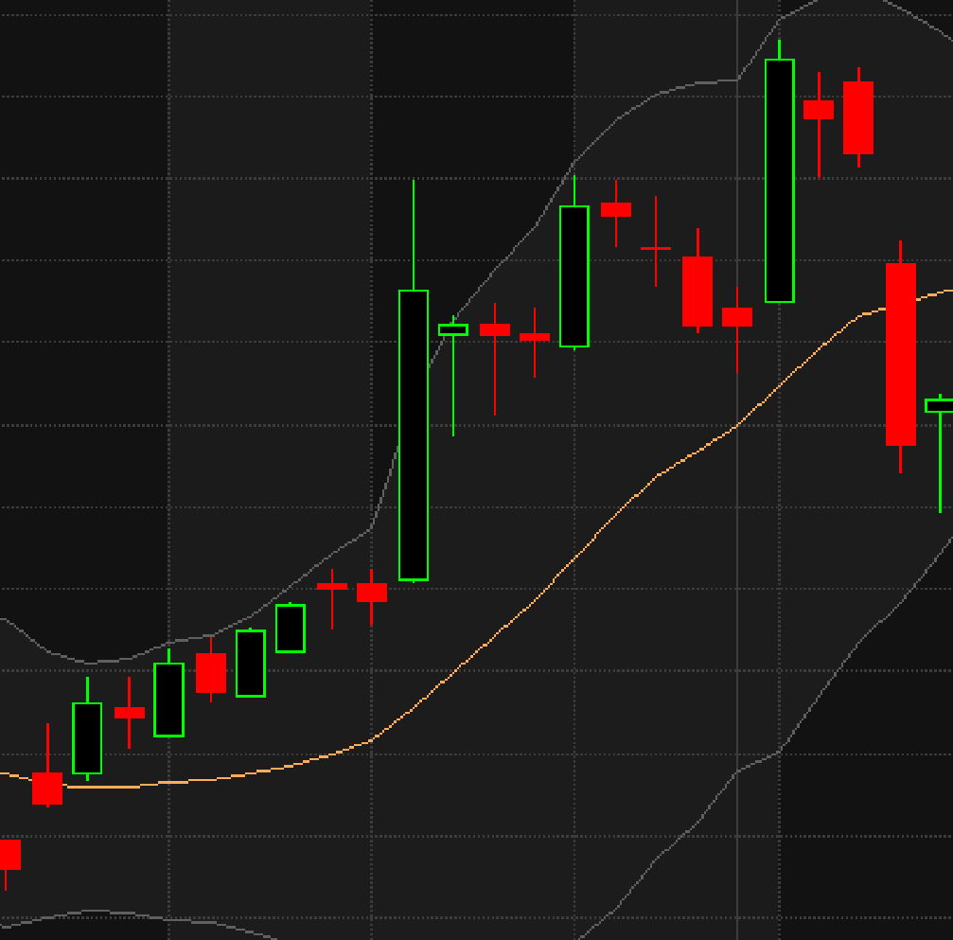


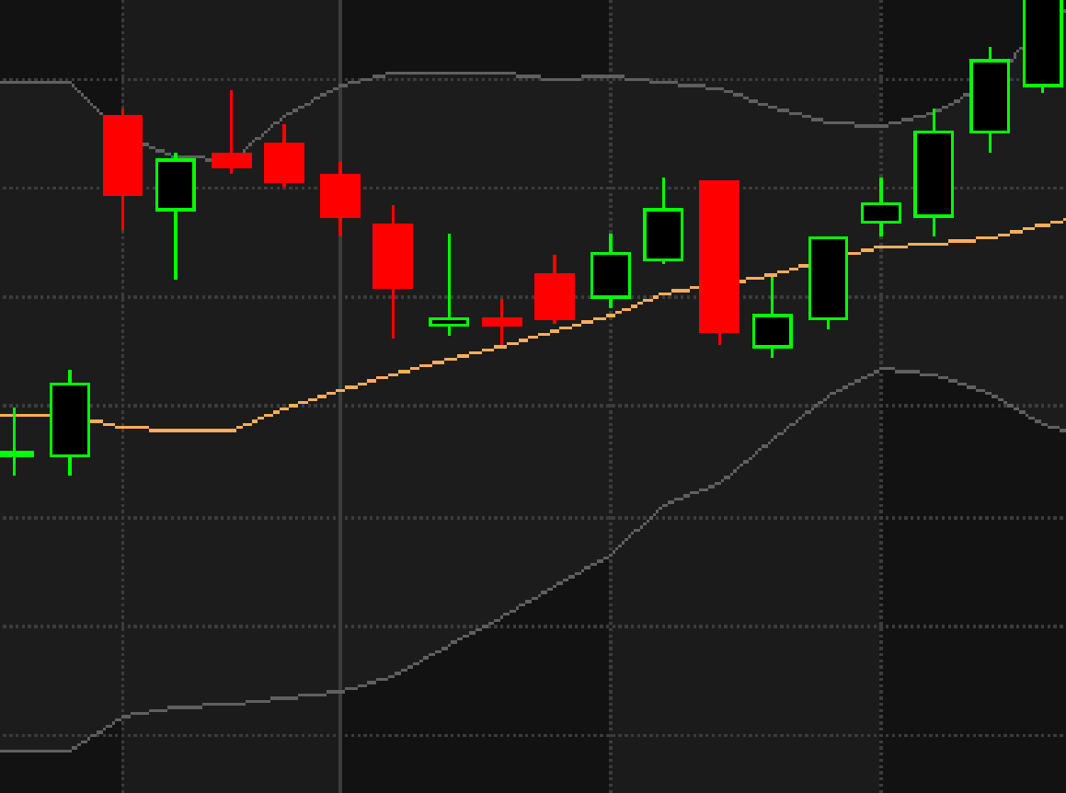
Design Outline: Core Elements - Genetic Programming and Trading
Evolution
Fitness
Genetic Programming (GP)
Trading analysis
(will later provide market access)

Slide 10

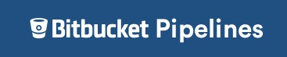
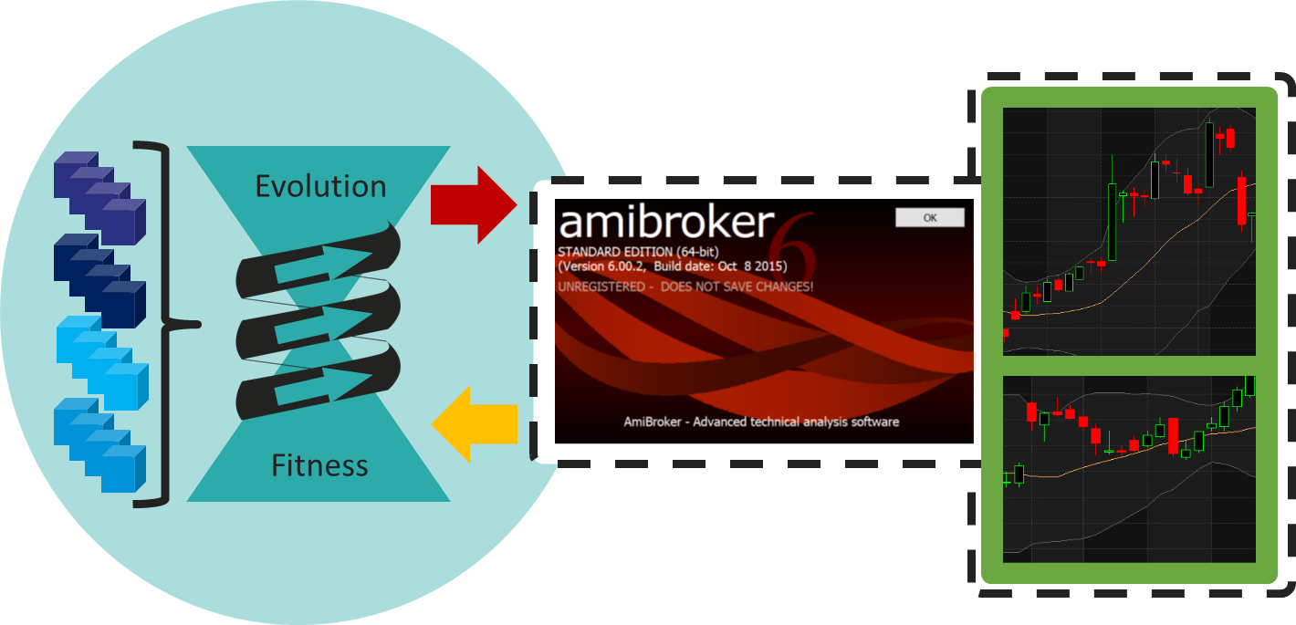
Production Environments
Eyrie Review
Analysis & Decision Making
Evolution Processing
Posco hardware
Input
data
Analysis
&
Decisions
Setup
data
Run
Eyrie
Posco hardware (master)
AWS or similar (slave)
Serialised

Slide 11
Design Block Diagram
Run
Eyrie
Setups
Building Blocks (Function and Terminal Sets)
This shows Phase 1, the MVP. Later Phases add functionality
Phase 1 MVP is evolution with data recording, excluding, for example, the Living Cells
Phase 1 shows viability in external processing, e.g. AWS, and therefore achieve builds and serialisation
Syntax and Parameters
CondorGP Setups
CondorGP
Data
Parameters
ECJ
Checkpointed Population, Fitness and Resource data

Slide 12
High Level Design - outline
1. Trading Strategies
2. Paper Trading
3. £ Trading
Data storage
CondorGP Data
Analysis of Results
Analysis: Trading
Strategies
Analysis:
Paper Trading Living Cell
Analysis: Trading
Strategies
1.1
2.1
3.1
Eyrie Review
Definition of all key characteristics
Setup: Trading
Strategies
Setup: Paper Trading Living Cell
Setup: Trading
Strategies
1.2
2.2
3.2
Evolution
Evolution: Trading Strategies
Evaluation: Trading
Strategies
Evolution: Trading Strategies
Evaluation: Trading
Strategies
Evolution: Trading Strategies
Evaluation: Trading
Strategies
Run
Eyrie
1.3a
2.3a
3.3a
Evaluation
using market data
1.3b
2.3b
3.3b
Market Data
Historical
Live data

Slide 13
High Level Design – function and loading outline
Category
Function
Loading
Estimates
Data storage
Receive and store timestamped input from all other functionality that is retrievable for analysis
On demand data storage, that scales with every functionality. Data storage simple, with appropriate metadata. Later extracts will be simple but may be large
< 10 Tb initially
Analysis of Results
Provides insight into data available to guide future experiments to better find increasing fitness
Scales to the data volume, and the determinations required. Genetic variation and per function analysis may be reasonably heavy loading. In-depth analysis expected
10+ analysis functions
Definition of all key characteristics
Specifies all of the following:
Experiments to be run, evolutionary function and terminal sets, evolutionary parameters, fitness functions, fitness test characteristics, living cell rulesets
Experiment definition and variation of characteristics require low resources, run on a weekly basis.
This is a manual process to specify experiment rotations. Then automated parameter setup creation to fill out the full requirements.
3-5
Evolution
Uses Genetic Programming techniques to create from the functions and terminals provided, evaluate and evolve Generations of Evolved Individuals. Many Populations will be required.
High load, will need resource management for both these two sections.
Loading will depend on experiment definition, each experiment will require >=1 Population. Optimisation of fitness function(s) (Evaluation), and of Evolutionary processes may be crucial - this is the heavy lifting.
Difficult to predict the loading until later in the development process. Will be considerable. Once the Evolution process is carefully tuned, the Evaluation may be the most load heavy.
Evolution:
<200 Populations each of 150 individuals\
Evaluation
using market data
Evaluates Evolved Individuals against specified market data, returning fitness score. Evaluates against historical or live data in historical, live-paper or live-£ contexts
Evaluation: Every individual
Market Data
Provides required market data
Initially weekly, then live data daily so light loading. Later on, if greater types of data are required could be heavy.
<30 initially

Slide 14
High Level Design – repeated abstracted unit
CondorGP Data
The abstracted unit, with some variation can run all three stages:
Trading Strategies
Paper-Trading
£ Trading
Priority and order of implementation goes in the 1, 2, 3 order:
Trading Strategies – only when some successful Trading Strategies are created is it worth developing the Paper-Trading
Paper-Trading – trading in full but paper not actual currency. As above, only when the Paper-Trading is successful is it worth developing the £ Trading
£ Trading – this is the ‘end game’ if £ Trading is successful enough, then business cashflow can be eventually safely managed, and considerable risk management actions put in place
Key is to build an implementation and architecture than can handle the volume and load, and then scale to future needs
Analysis
x.1
Eyrie Review
Setup
Setup, Evolution & Evaluation, Analysis.
A repeating loop to find better outcomes.
x.2
Evolution
Evaluation
Evolution
Evalution
Evolution
Evalution
Evolution
Evalution
x.3a
x.3a
Run
Eyrie
x.3a
x.3a
x.3b
x.3b
x.3b
Market data
x.3b
KEY:
Logic flow
Evaluation
Outcomes
Evolution
core
Parameter
and nodes

Slide 15
High Level Design – running the abstracted unit
Setup to Evolution to Outcome Loop
CondorGP Data
The abstracted unit, with some variation can run all three stages:
Trading Strategies
Paper-Trading
£ Trading
The key is how to run the abstracted unit repeatedly at high volume
A high number of experiments is expected to methodically cover the search-space, these are defined in x.1
x.3 will inform as to whether each experiment is worthwhile
RunEyrie (x.2a and x.2b) will therefore need considerable resources to reach near-success Outcomes
Therefore requirements:
Parallelisation. Primarily for RunEyrie, at flexible scaling according to no. of experiments. Capability to parallel run all is required.
Coordination. To automatically run the other functionality as needed
Analysis
x.1
Eyrie Review
Setup
x.2
Evolution
Evaluation
Evolution
Evalution
Evolution
Evalution
Evolution
Evalution
x.3a
Run
Eyrie
x.3a
x.3a
x.3a
x.3b
x.3b
x.3b
Market data
x.3b
KEY:
Logic flow
Evaluation
Outcomes
Evolution
core
Parameter
and nodes

Slide 16
Part Two – Design Epics
N.B.
These are a 1st pass, and further High Level and Technical Design work will change them => so advisory only at this stage

Slide 17
18/02/07: See ODR, rows 7 & ff
17/12/30: See Notes Rows 10672 & ff
Edits 18/02/13
18/08/01: This is now out of date
Functionality and Epics
Undertake and visualise Data Analyses
Perform the range of analyses of GP and Trading and provide graphic views thereof
Analyse and specify all CondorGP Setups
Specify Setups, by processing existing results and new and existing search space progress
Define GP Core input
Create full 'Setups' using Parameters controlling GP output syntax, Fitness Function, Building Blocks, and Prioritised Evolution
Specify Fitness Function (includes LC Fitness)
Run GP Core
Progress prioritised evolution of existing and new GP Populations (both simple and advanced)
Data Output / Input
Capture, store and provide requisite data for evaluation and future analyses
Run Living Cell (paper / £) trading process
Run LC process to trade, update Cells based on trading results, sapping, growth, clone, death
Provide a scalable process, continuously integrated and delivered
Allow the event steps and processing to interlink and be undertaken within set timescales
Achieve Continuous Integration and Continuous Delivery to appropriate platforms
Eyrie Review
Run Eyrie

Slide 18
Eyrie Review
Functionality and first pass Epics
A - Undertake and visualise Data Analyses
Perform the range of analyses of GP and Trading and provide graphic views thereof
Stories
Undertake the required analyses
Update the visualisations with the latest analysis data
Notes
Analysis required not listed in full at this point
Analysis will likely cover the following areas / questions:
Simple results from Evolving Populations (Fitness improvement, consistency of improvement)
More advanced results from Evolving Populations (Genetic diversity, local minima identification)
Wider evolutionary results: e.g. Which Building Blocks (FnT) are most influential (single and groups of Building Blocks)
Results from Living Cells (Trading performance, Cell population stats, income stability and longevity)

Slide 19
Eyrie Review
Stories for each Epic
B - Analyse and specify Setups
Specify Setups, by processing existing results and new and existing search space progress
Stories
Make ready a list of defined and prioritised Setups to be selected from and created when new input is needed to process the GP Core
Identify from Data Analysis results which Evolving Populations are worth progressing
Identify from Data Analysis results areas of the search space worth opening up or closing down

Slide 20
Eyrie Review
Stories for each Epic
C - Define GP Core input
Create full 'Setups' using Parameters controlling GP output syntax, Fitness Function, Building Blocks, and Prioritised Evolution
Specify Fitness Function (includes LC Fitness)
Stories
Create the Setup
Specify Fitness Functions
Create the Building Blocks (Functions and Terminals set)
Confirm all possible syntax combinations are legal in output language
Place latest Setup in list of prioritised Setups for evolutionary progress by GP Core

Slide 21
Run
Eyrie
Stories for each Epic
D - Run GP Core
Progress prioritised evolution of existing and new GP Populations (both simple and advanced)
Stories
Progress new Setups as created Evolving GP Populations, with 50 individuals and 100 generations
Progress all prioritised existing Evolving GP Populations, by 100 generations
Continue progressing Evolving GP Populations to make best use of alloted evolution resources
Establish new external (slave) populations
Progress existing checkpointed population externally as slave

Slide 22
Run
Eyrie
Stories for each Epic
E - Data Output / Input
Provide, capture and store the requisite data for evolutionary evaluation and future directional analyses
Input Stories
Updated market data is available for use, i.e. after market close trading
Output Stories
Grab data at all the requisite timings across the process to enable later analysis
Store all data in a safe, ordered and accessible format for later analysis
Notes
Only core initial and or fundamental data listed at this point
The next slide provides input on what data output is required, and the use of each data point
Data output will be required pre, post and during GP Core and Living Cell processing

Slide 23
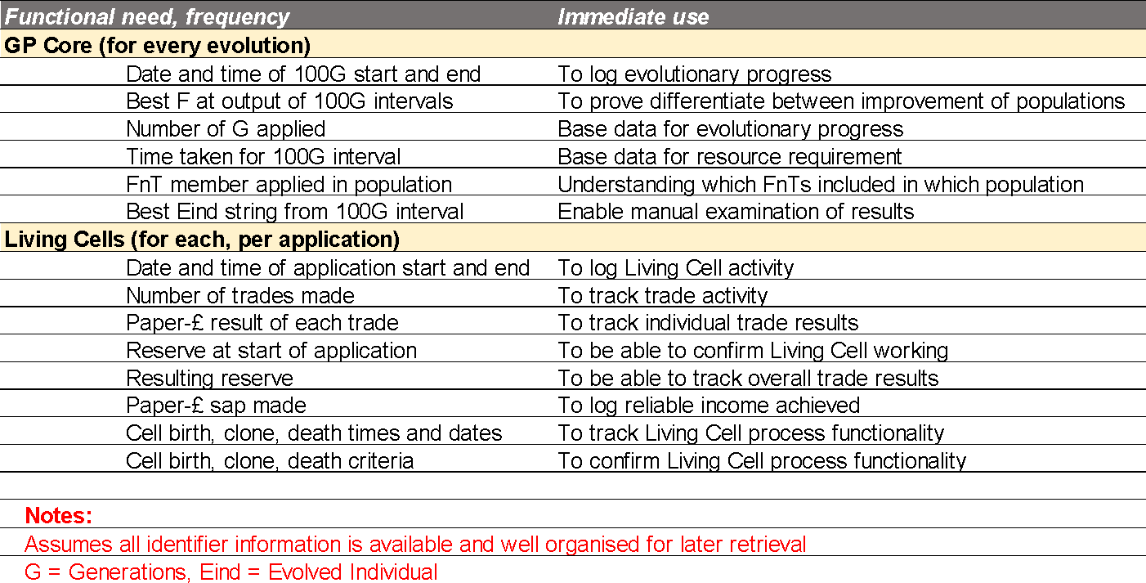
Run
Eyrie
Stories for each Epic
E - Data Output - Requirements

Slide 24
Run
Eyrie
Stories for each Epic
F - Run Living Cell (paper / £) process
Run LC process to trade, update Cells based on trading results, sapping, growth, clone, death
Stories
Note: All Living Cells will be paper (i.e. not trading live) for the foreseeable future
Prioritise birth of new Living Cells with the each of the latest best new individuals from the GP Core Outputs
Birth new Living Cells
Clone Living Cells that are performing well
Kill off Living Cells that are not performing well
Sap Living Cells to provide reliable income from trading activity
Run Living Cells with latest data to establish trades and execute trade orders

Slide 25
Run
Eyrie
Stories for each Epic
G - Provide a scalable, linked process
Allow the event steps and processing to interlink and be undertaken within set timescales
Stories
Updated market data is available for use, e.g. after market close trading
Living Cell processes run efficiently and within specified time allotted
GP Core progress according to the prioritised lists of 'Setups' and Evolving Populations
Data Analyses are undertaken when GP Core or Living Cell activities have completed
Data Output during or immediately after Living Cell, GP Core or Data Analysis processes
The activity cycle is repeatable at the specified frequency (currently set as weekly, could be daily)
Run GP Core according to latest priorities
Run Living Cells, trade as required
Analyse data and set ongoing priorities
When the activity cycle is adjusted, the processing is scaled and the cycle is thus achieved in the specified time
The cost and resource requirement for an activity cycle frequency and scale can be forecast

Slide 26
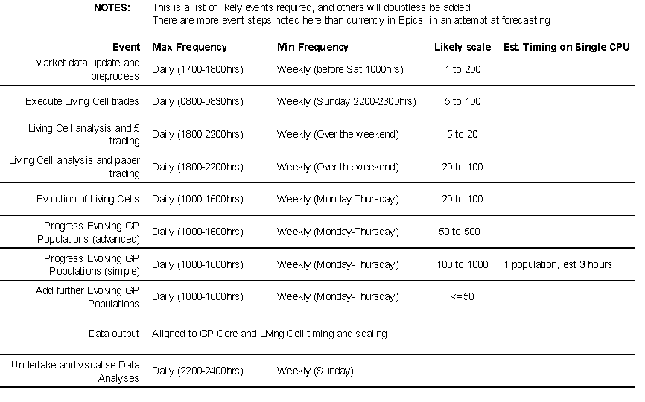
Run
Eyrie
Events, min and max est. frequencies & est. timing

Slide 27
Thank you
Email address and website below
PLEASE ASK QUESTIONS

